Slide 1
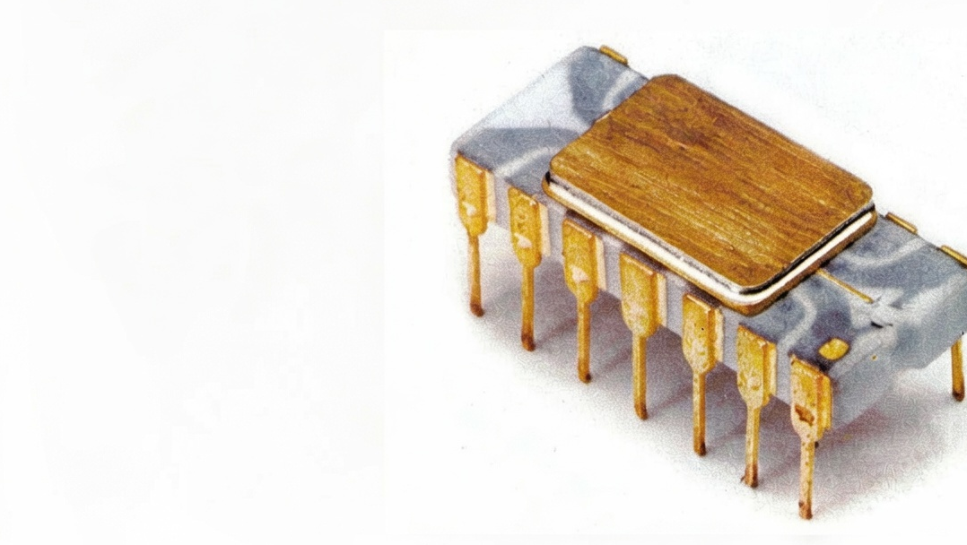

Intro to Bitcoin for Banking Leaders
Andrew Begin
CSO, Galoy

Slide 2
Agenda
Digital Transformation of Money
Opportunity for Banks
Q&A and Further Reading

Slide 3
Photo: IEEE.org

Slide 4
"There is no reason anyone would want a computer in their home."
Ken Olsen, 1977
Founder, Digital Equipment Corporation (DEC)
Photo: IEEE.org

Slide 5
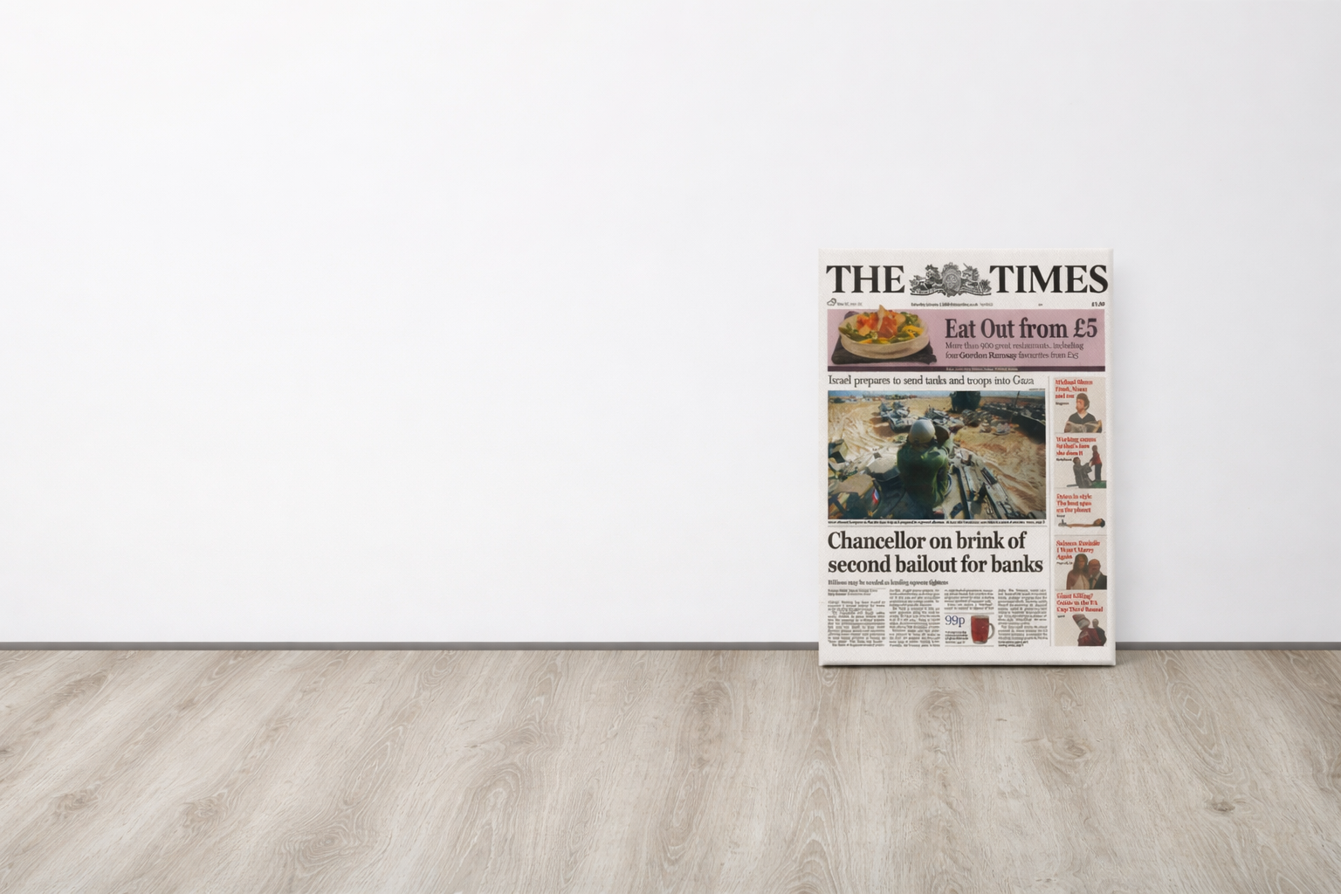
Photo: Bitcoin Shirt

Slide 6
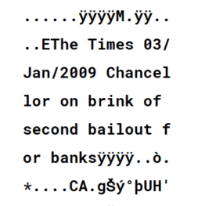
Photo: Bitcoin Shirt

Slide 7
…an electronic payment system based on cryptographic proof instead of trust, allowing any two willing parties to transact directly with each other without the need for a trusted third party.
Satoshi Nakamoto, 2008
Bitcoin Whitepaper
Source: The Bitcoin Whitepaper

Slide 8
"Bitcoin looks like a clever notion that will likely amount to little more than a curiosity."
The Economist, 2011
Photo: Bitcoin Shirt

Slide 9
"You have to really stretch your imagination to infer what the intrinsic value of Bitcoin is. I haven't been able to do it."
Alan Greenspan, 2013
Former Fed Chair
Photo: Bitcoin Shirt

Slide 10
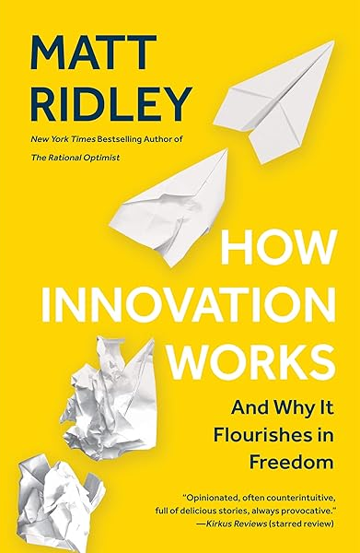
Photo: Bitcoin Shirt

Slide 11
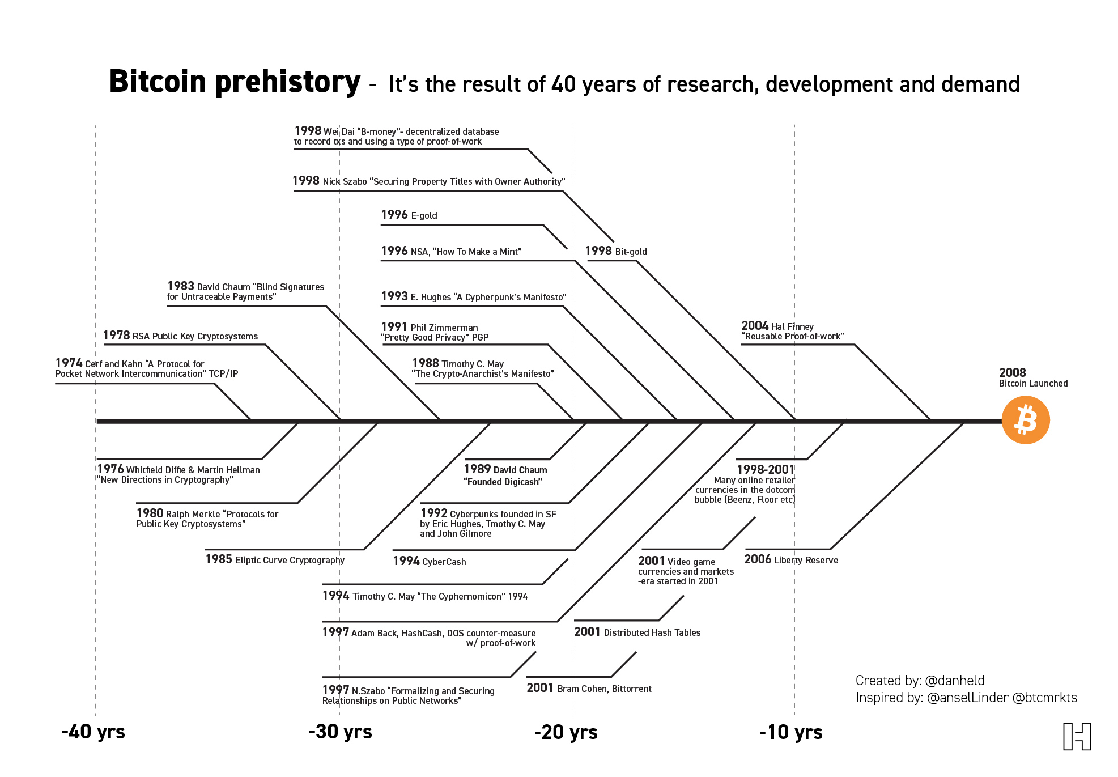
Source: danheld.com

Slide 12
Personal Realization

Slide 13
Personal Realization
Our financial system is built for a world that requires intermediaries.

Slide 14
Personal Realization
Our financial system is built for a world that requires intermediaries.
We no longer live in that world.

Slide 15
Three monetary epochs
Asset-based
physical money
3000 BC
1600 CE
2009 CE

Slide 16
Three monetary epochs
Asset-based
physical money
Debt-based
ledger money
3000 BC
1600 CE
2009 CE

Slide 17
Three monetary epochs
Asset-based
physical money
Debt-based
ledger money
Asset-based
ledger money
3000 BC
1600 CE
2009 CE

Slide 18
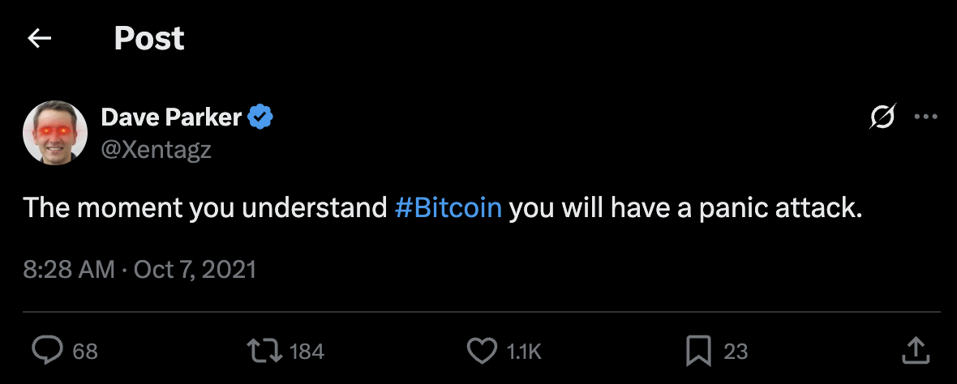
Source: Dave Parker

Slide 19
1000 Years of Technological Disruption
Adapted from BofA Global Research

Slide 20
1000 Years of Technological Disruption
Printing Press
Adapted from BofA Global Research

Slide 21
1000 Years of Technological Disruption
Steam Engine
Printing Press
Adapted from BofA Global Research

Slide 22
1000 Years of Technological Disruption
Microprocessor
Steam Engine
Printing Press
Adapted from BofA Global Research

Slide 23
1000 Years of Technological Disruption
World Wide Web
Microprocessor
Steam Engine
Printing Press
Adapted from BofA Global Research

Slide 24
1000 Years of Technological Disruption
Bitcoin
World Wide Web
Microprocessor
Steam Engine
Printing Press
Adapted from BofA Global Research

Slide 25

What Is So Disruptive About Bitcoin?
What Is So Disruptive About Bitcoin?
Photo: seti.org

Slide 26
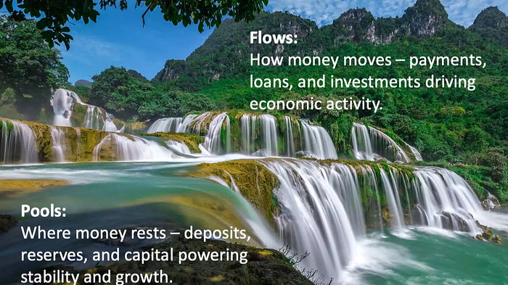
“Banking is simple, it is just pools and flows”
Source: Dion Lisle

Slide 27
Bitcoin
asset
network
“Banking is simple, it is just pools and flows”

Slide 28
decentralized
scarce
Bitcoin
asset
network
“Banking is simple, it is just pools and flows”

Slide 29

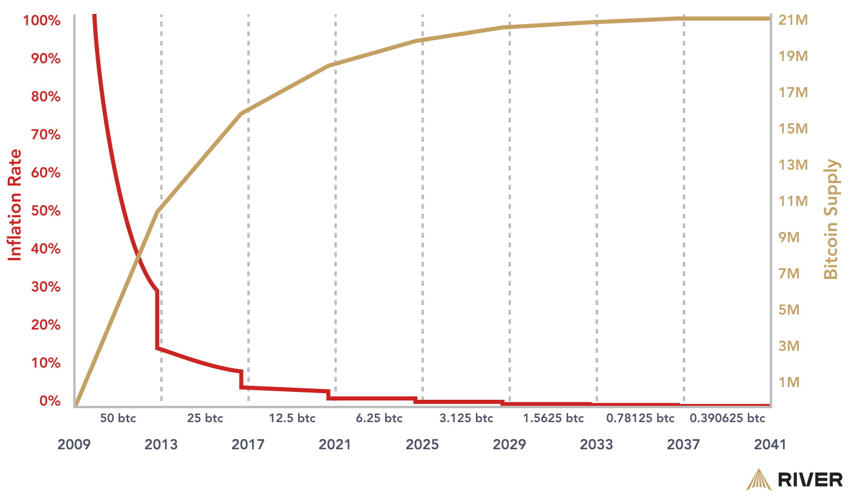
Scarce Asset
Source: River

Slide 30
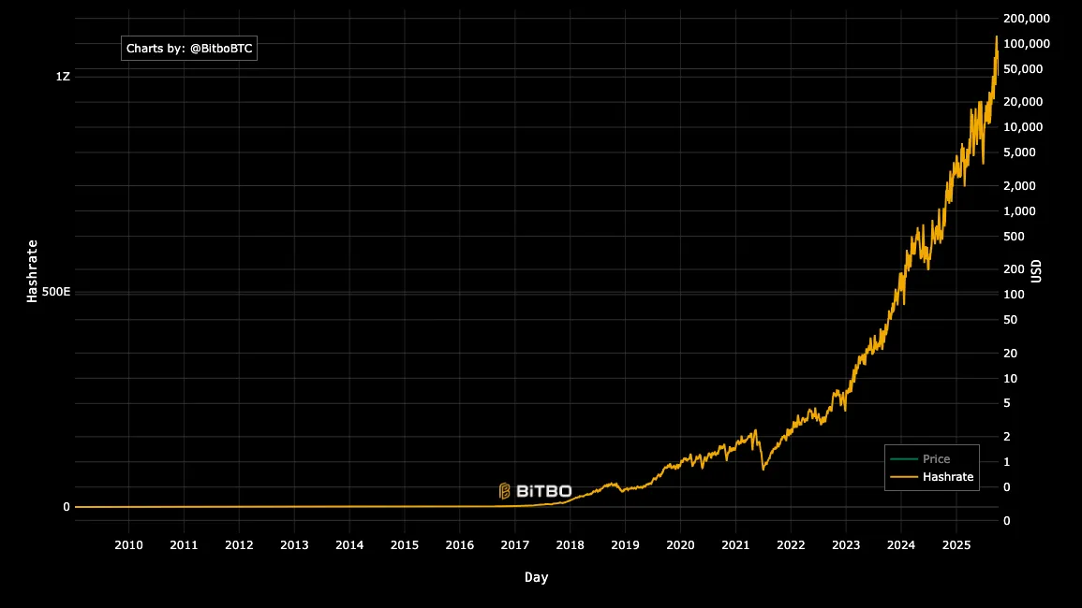


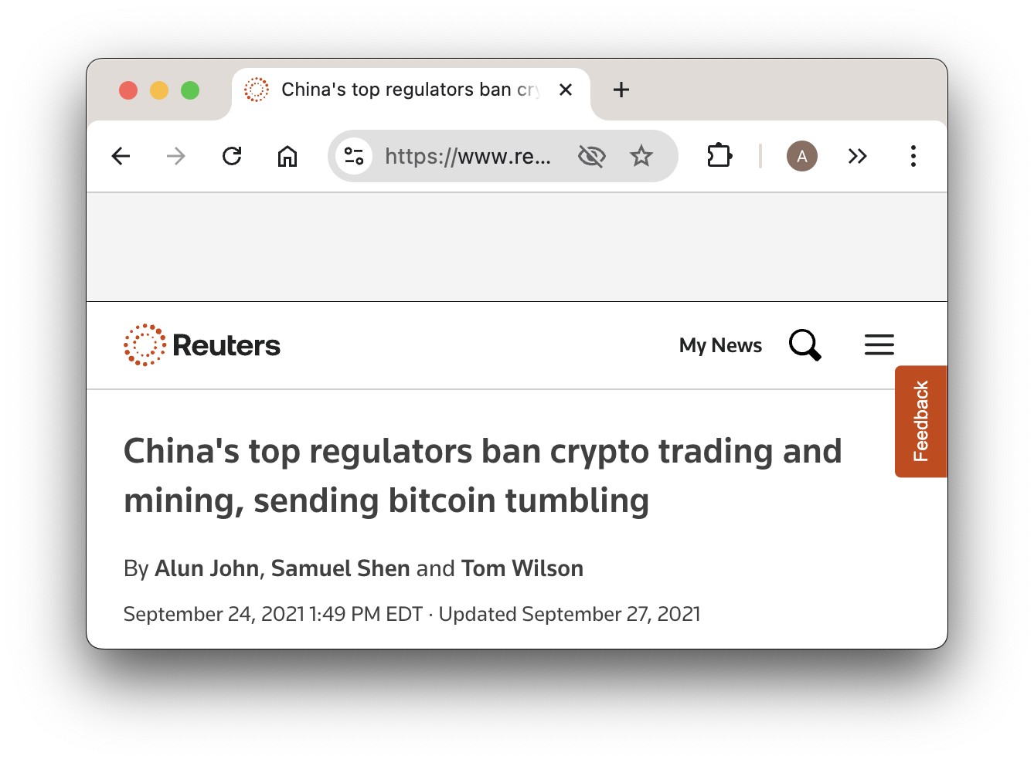




`
`
Decentralized Network
Source: Bitbo – adapted for legibility & illustration

Slide 31
`
`
Decentralized Network
Source: Bitbo – adapted for legibility & illustration

Slide 32
Three monetary epochs
Asset-based
physical money
Debt-based
ledger money
Asset-based
ledger money
3000 BC
1600 CE
2009 CE

Slide 33
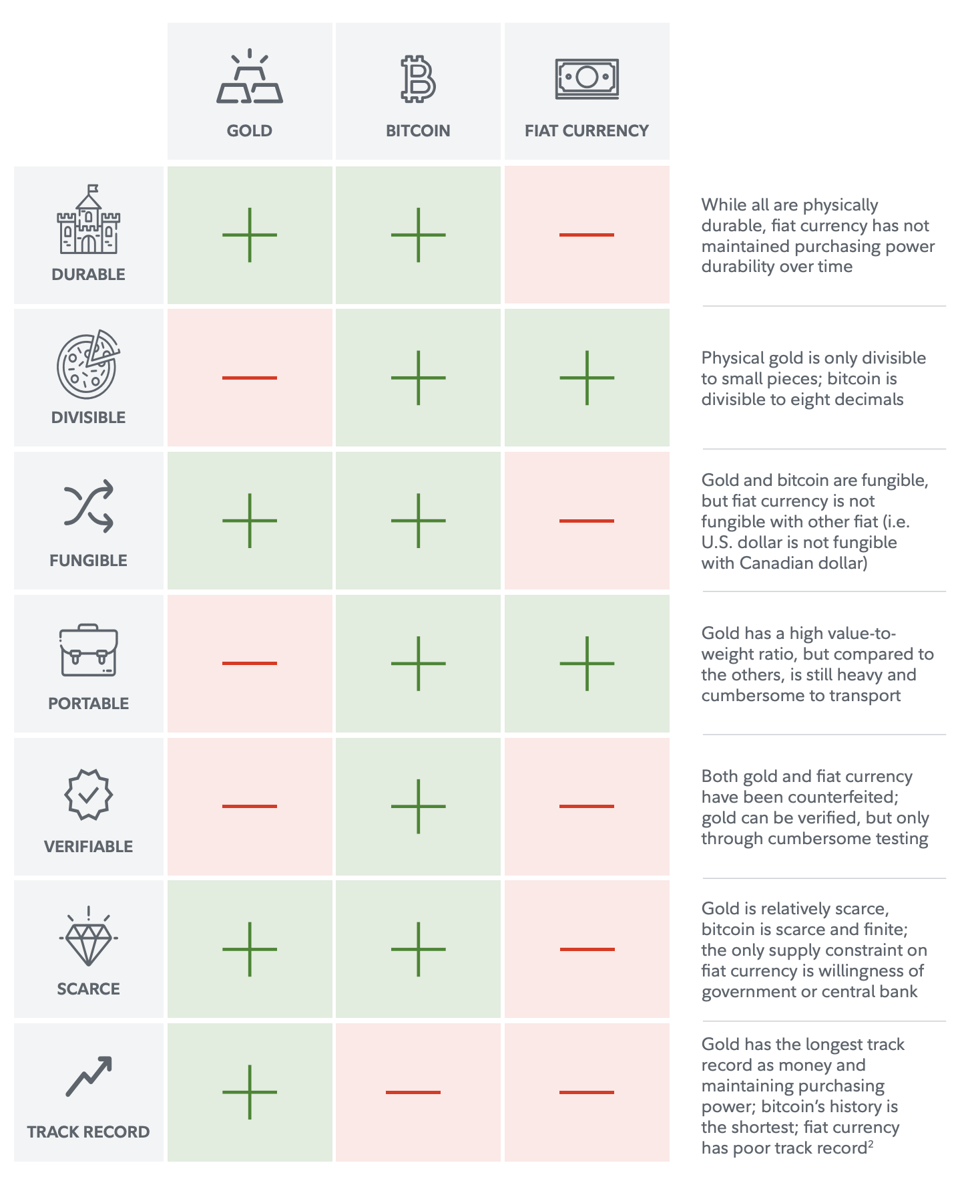
“Bitcoin’s Value is Driven by its Enforceable Scarcity”
Fidelity, 2023
Bitcoin-First: Revisited
Source: Fidelity Digital Assets

Slide 34
Bitcoin’s Value is Driven by its Enforceable Scarcity
Fidelity, 2023
Bitcoin-First: Revisited
Source: Fidelity Digital Assets

Slide 35
Bitcoin’s Value is Driven by its Enforceable Scarcity
Fidelity, 2023
Bitcoin-First: Revisited
Source: Fidelity Digital Assets

Slide 36
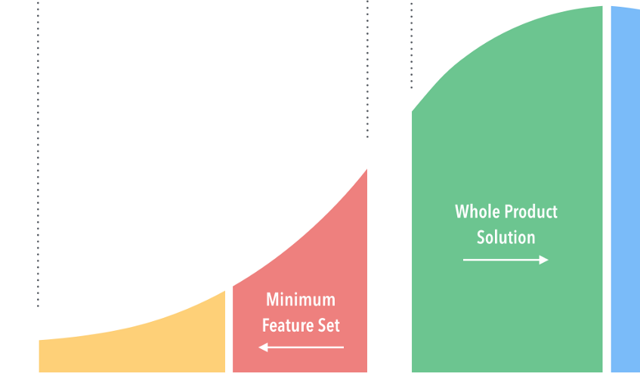
Three Cohorts of Adoption
Banks
Banked
Unbanked

Slide 37
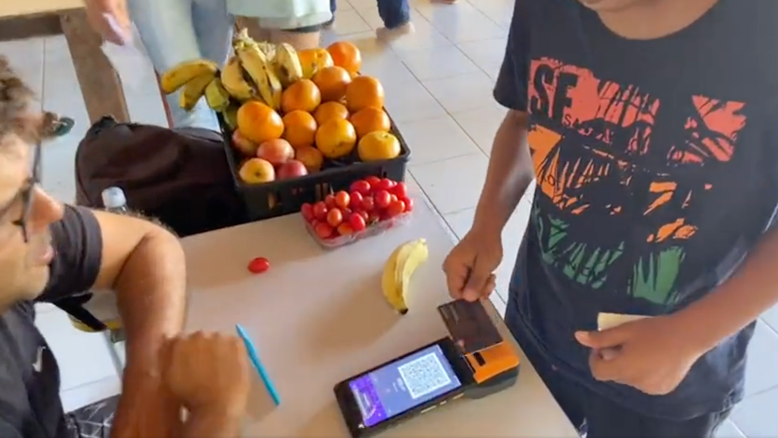
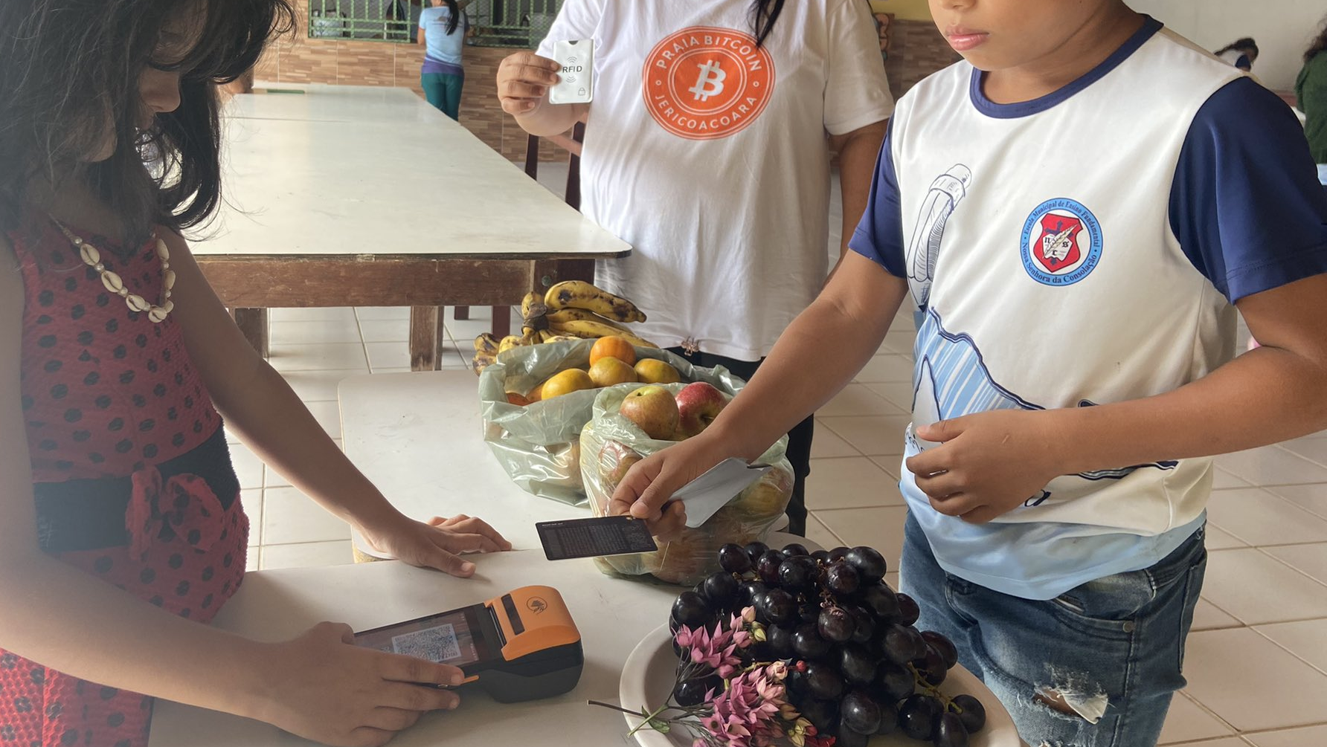
But most of all, bitcoin is money.
The Unbanked
BUT. It possesses properties unlike any other asset, and any other network, on the planet.
Photo: @BitcoinBeachBR

Slide 38
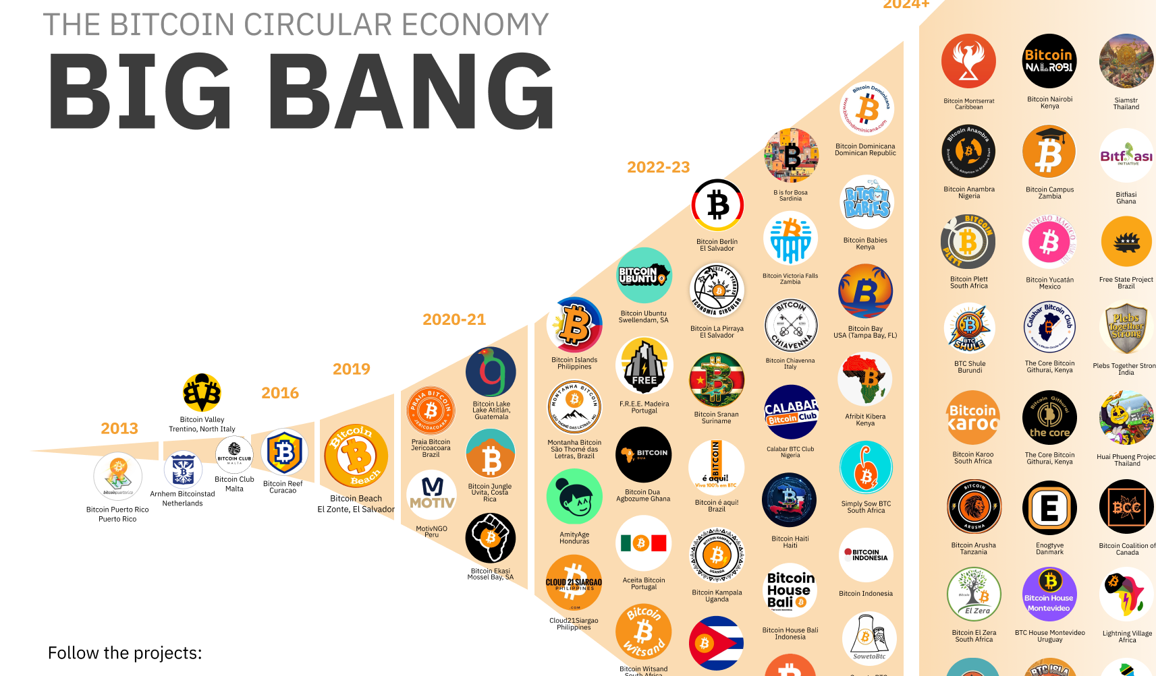
The “Unbanked”

Slide 39
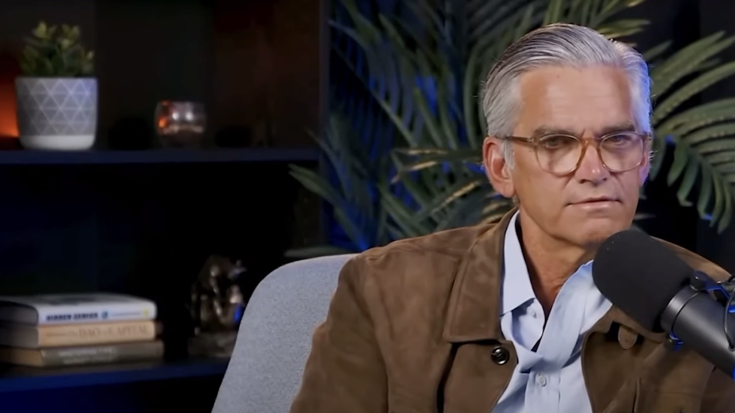
The Banked

Slide 40
“You can put all your money in the S&P 500 and you’re not gaining any relative wealth at all. That’s a startling insight.”
Tad Smith
Former CEO, Sotheby’s
Source: Tim Kotzman

Slide 41
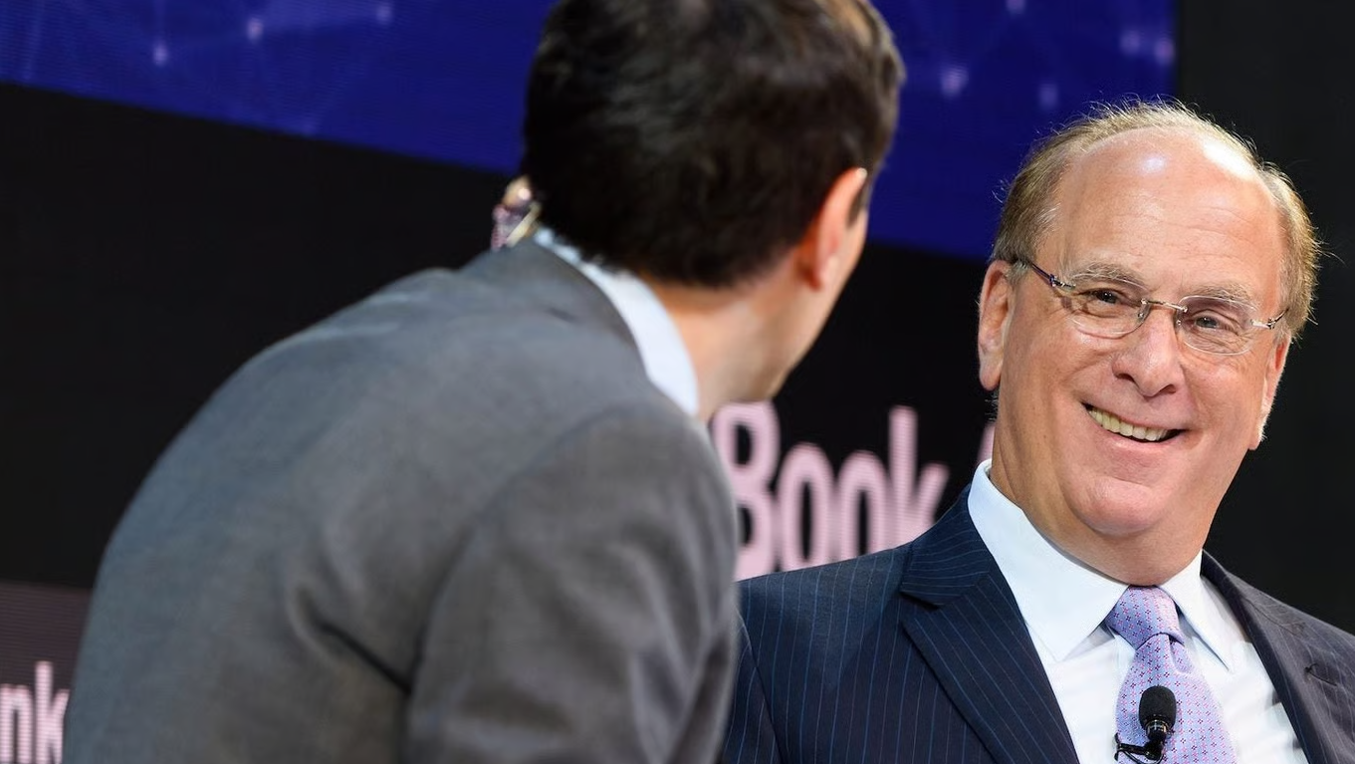
The Banks

Slide 42
“BlackRock’s U.S.-based Bitcoin exchange-traded product (ETP) was the largest exchange-traded product launch in history”
Larry Fink
CEO, Blackrock
Source: Blackrock

Slide 43
“If the U.S. doesn’t get its debt under control, if deficits keep ballooning, America risks losing that position to digital assets like Bitcoin.”
Larry Fink
CEO, Blackrock
Source: Blackrock

Slide 44
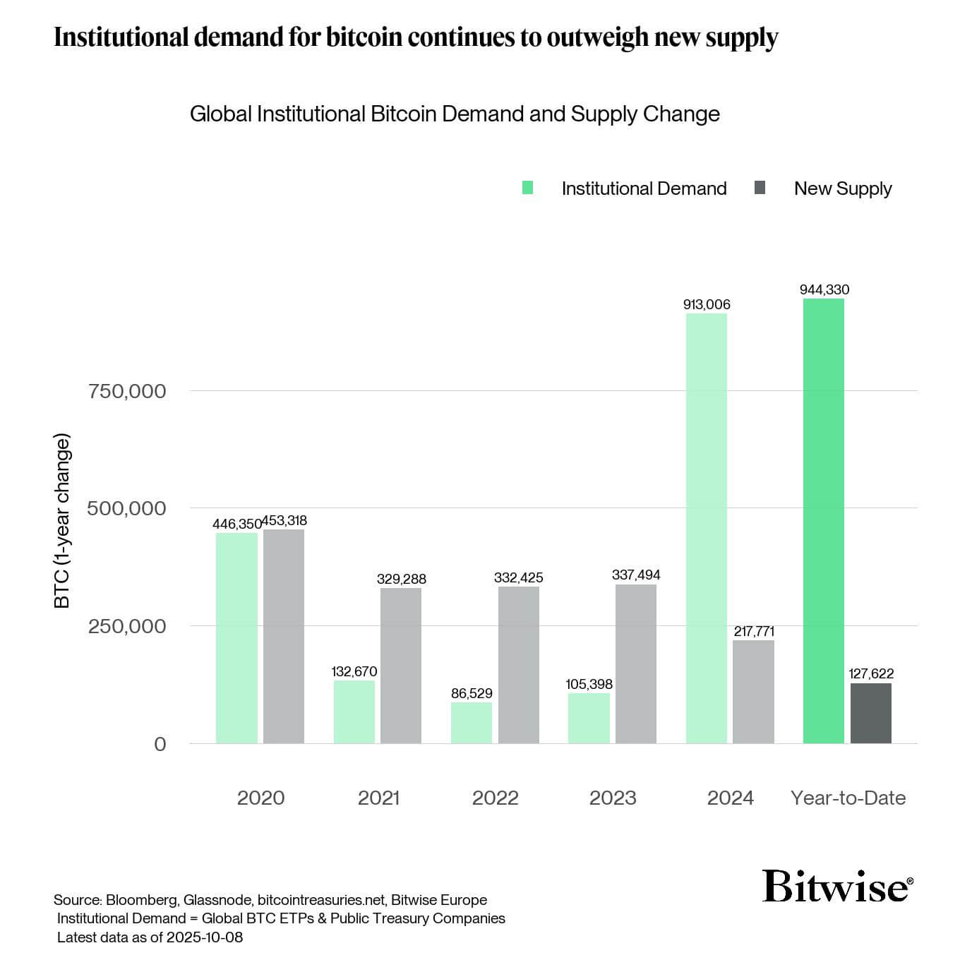

Demand = 7.4x Supply
Source: Andre Dragosch - Updated for legibility

Slide 45
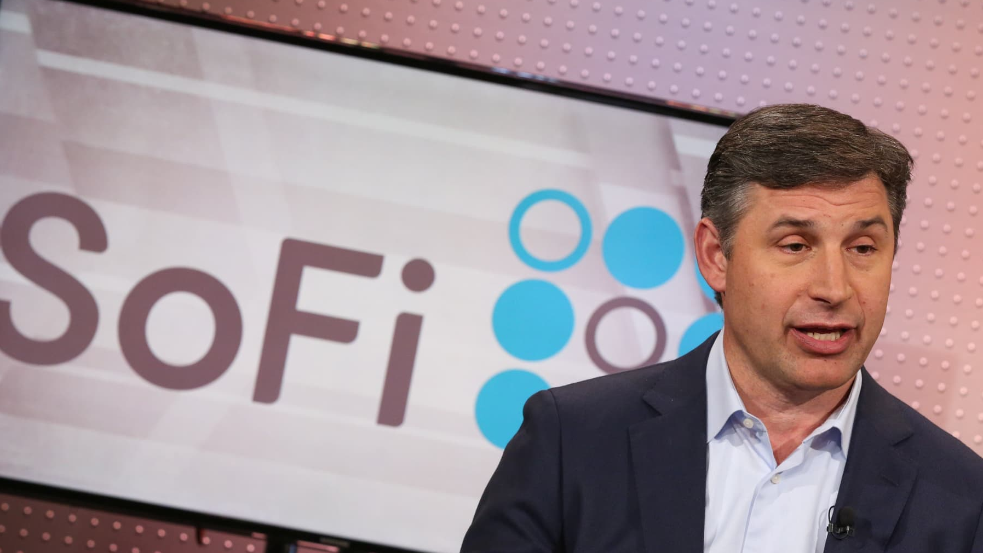
“I heard many people that were naysayers about bitcoin saying many of the things I heard from naysayers about the internet back in 1999-2000.”
Anthony Noto
CEO, SoFi
Source: Crypto in America

Slide 46
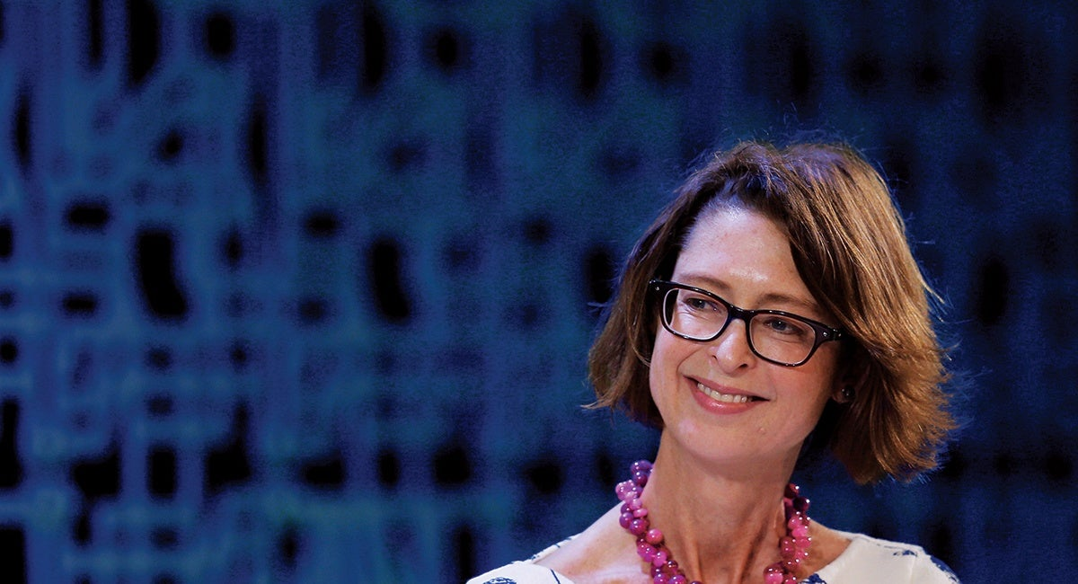
“This looks real, this is something going on here. It could lead to radical changes in our business. And wouldn’t that be interesting and exciting.”
Abigail Johnson
CEO, Fidelity
Source: a16z crypto

Slide 47

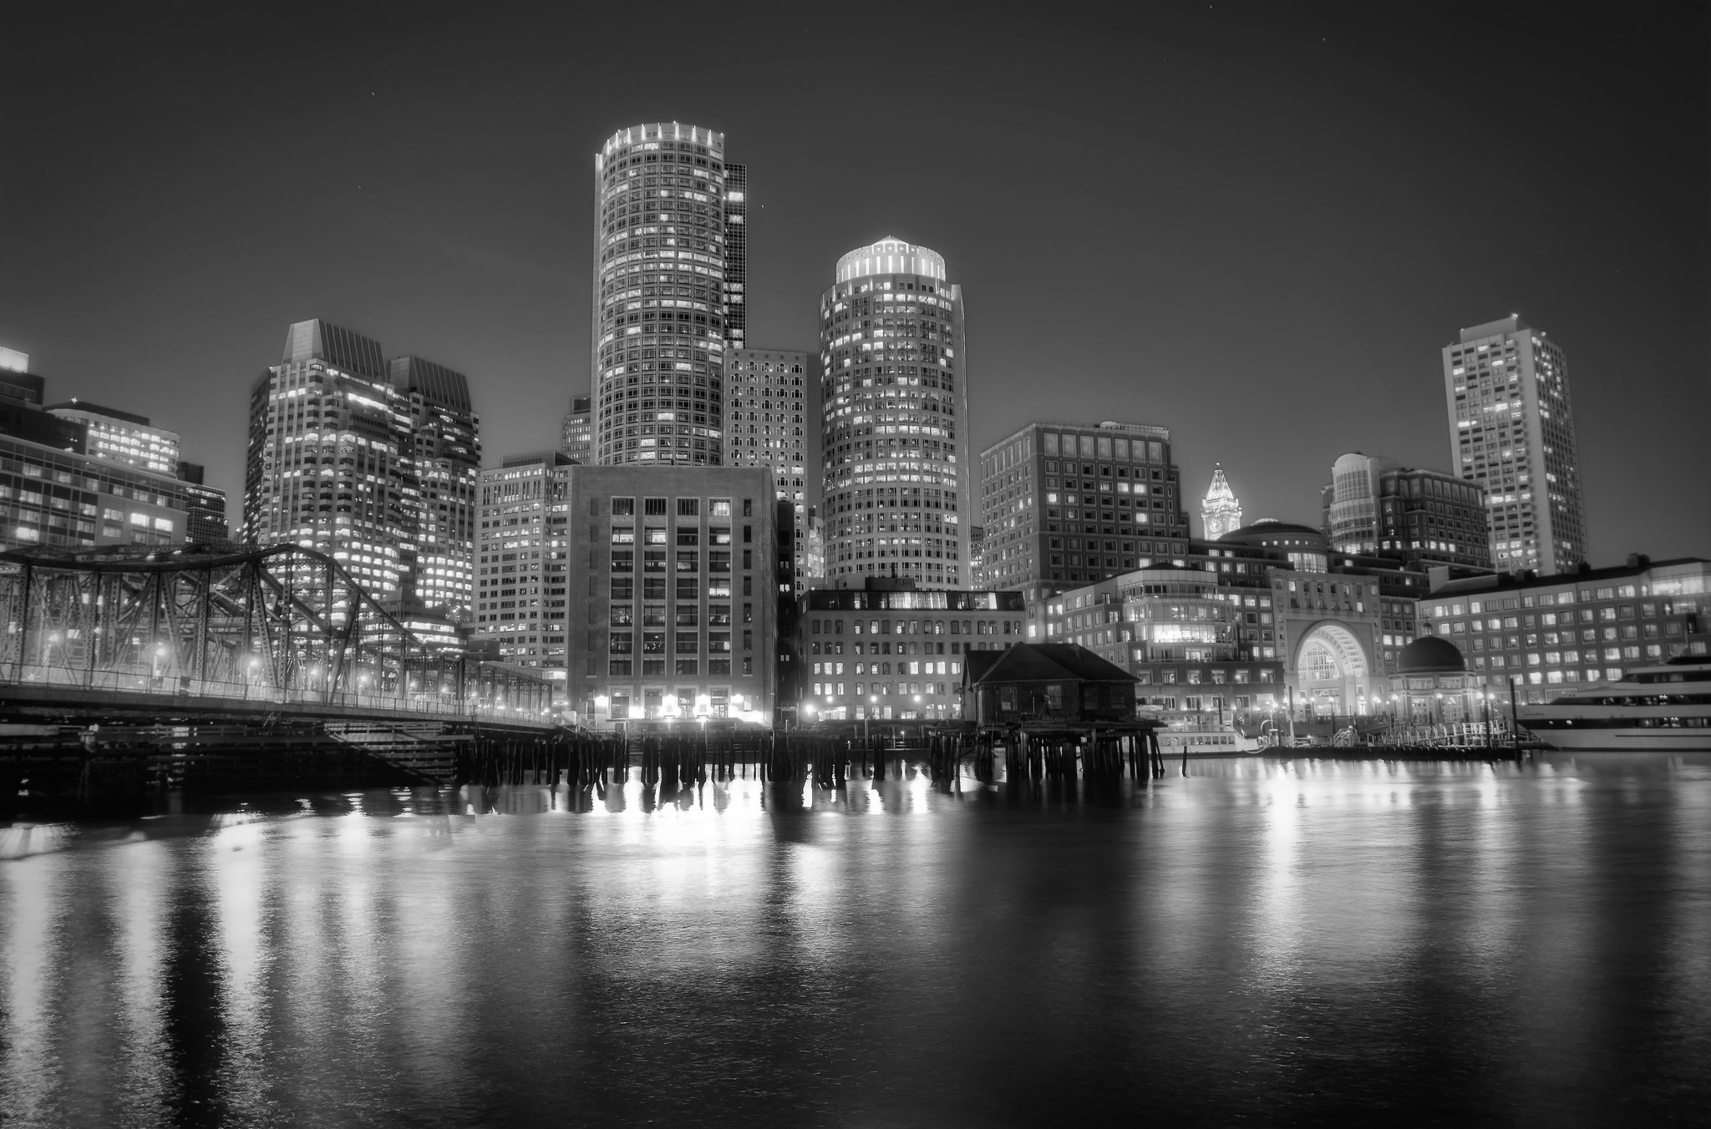
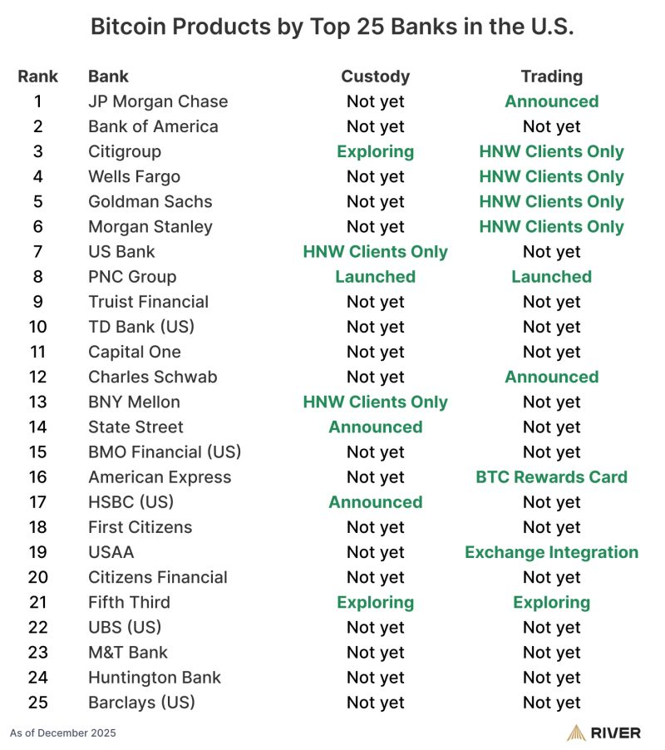
It’s Still Early
14 of top 25 largest US banks reportedly have or are building bitcoin products.
Source: River Financial, Inc.

Slide 48
2025 Regulatory Updates
Mar 28: FDIC Rescinds FIL-16-2022
May 7: OCC Clarifies custody & execution regs
Nov 18: OCC Clarifies custody & execution regs
Jan 23: SEC Rescinds SAB-121
Apr 24: Fed Revises guidance
Jul 14: Interagency Statement on Risk Management for Crypto-Assets
Dec 8: CFTC Launches Digital Assets Pilot
January 2025
December 2025
Sources: SEC, FDIC, OCC, Federal Reserve, National Law Review - Not an exhaustive list of related regulatory activity.

Slide 49
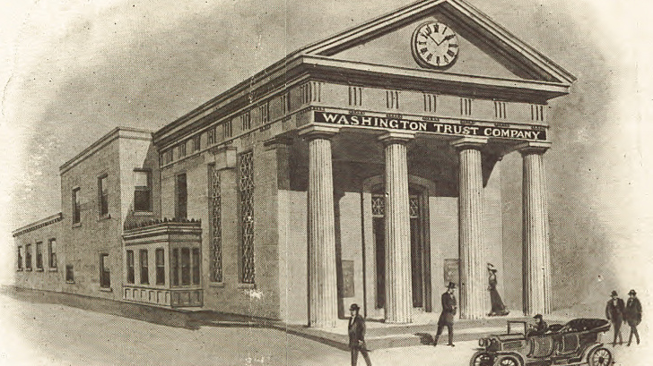
Opportunity for Banks

Slide 50
Opportunity for Banks
1. Education & Guidance
2. Custody & Safekeeping
3. Currency Exchange
4. Payments
5. Asset-backed Lending
6. Correspondent Banking

Slide 51

Education & Guidance

Slide 52
Education & Guidance
14% of US Adults own crypto
35% of US Adults “Know something about crypto”
This happened largely outside their banking relationship
Data: Gallup

Slide 53
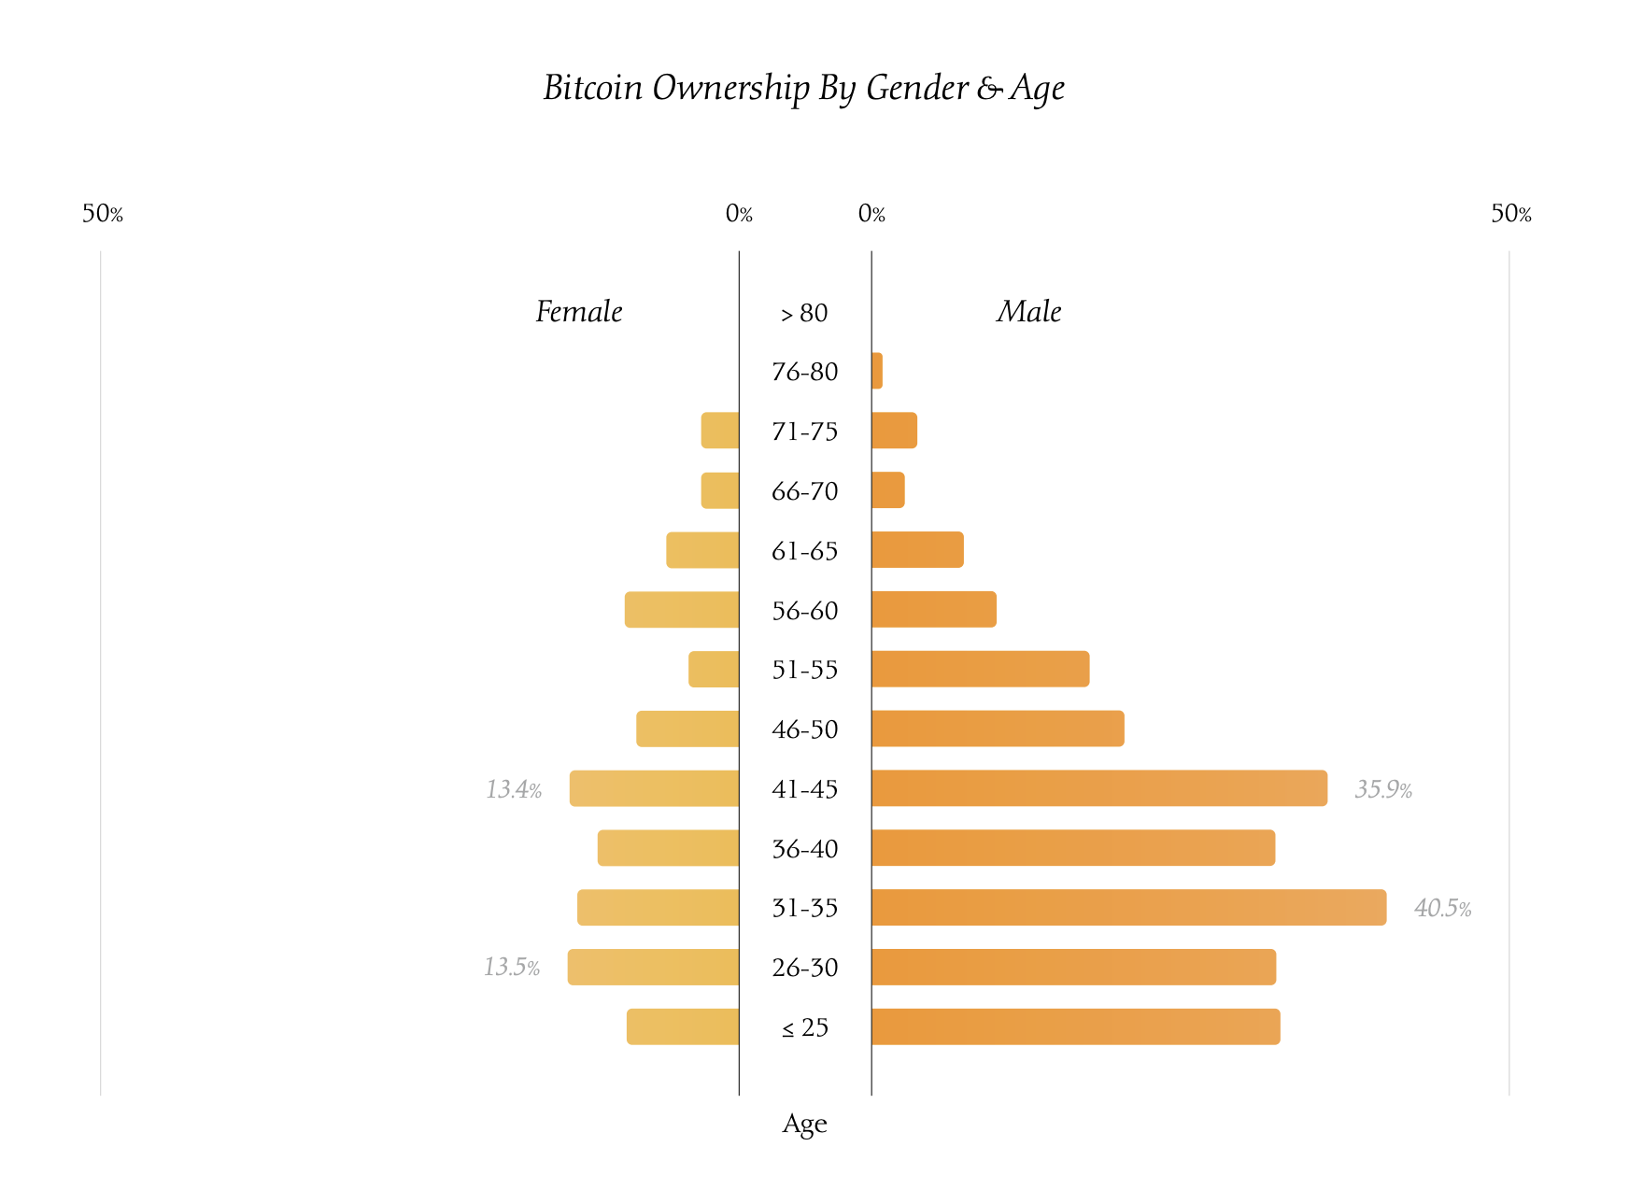
Education & Guidance
40% of males and 13% of females aged 31-35 own Bitcoin
Source: The Nakamoto Project

Slide 54
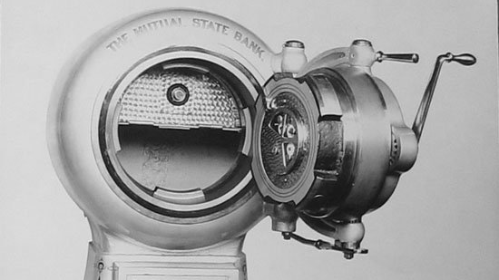
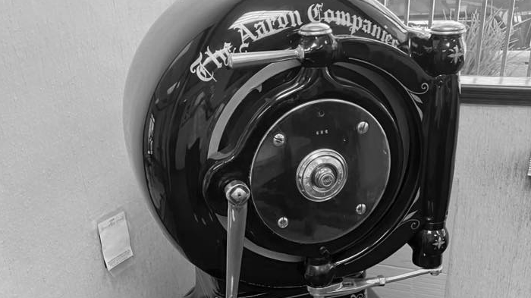
Bitcoin and banks: brethren?
Custody & Safekeeping
Custodian Integration → Partner with qualified custodian
Self-Custody Support → Customer-controlled
Bank-Managed Custody → Bank-controlled
Source: River Financial, Inc.

Slide 55
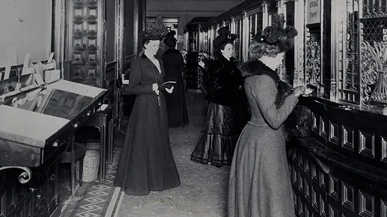
BTC/USD Exchange
Enable customers to invest without leaving the trusted environment of the bank
Add net new fee revenue
Reduce “soft-switching” toward fintechs

Slide 56
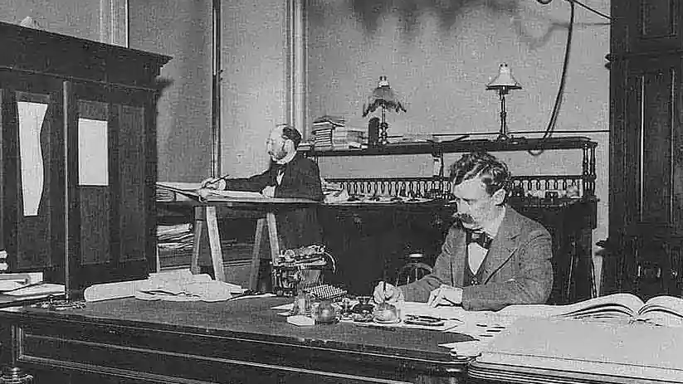
Payments
On-chain bitcoin payments (akin to Fedwire)
Layer 2 Lightning Network (real time payments)
Digital bitcoin wallet (eBanking, mobile channels)

Slide 57
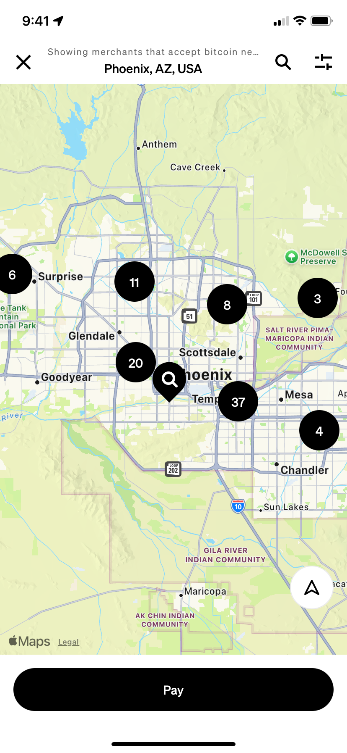
Payments
YOU ARE HERE
Square: 4M US merchants can accept BTC (or USD) via Lightning Network (Nov ‘25)
SoFi & Lightspark:
Remittances payments over Lightning: USD → BTC → MXN
Source: CashApp “Pay with bitcoin” Map

Slide 58
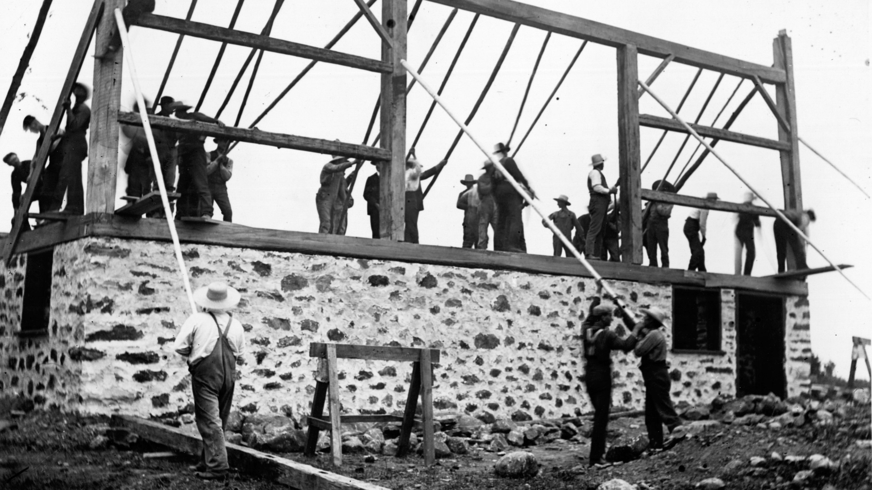
Asset-backed Lending
A win for banks
Overcollateralized (~50% LTV) with liquid, 24/7-priced collateral
Higher interest rates with lower credit risk
Continuous collateral monitoring improves balance sheet efficiency

Slide 59
Asset-backed Lending
A win for banks
Overcollateralized (~50% LTV) with liquid, 24/7-priced collateral
Higher interest rates with lower credit risk
Continuous collateral monitoring improves balance sheet efficiency
A win for customers
Access liquidity without selling long-term assets
Borrow from a regulated, trusted bank counterparty
Avoid reliance on opaque or untested counterparties

Slide 60
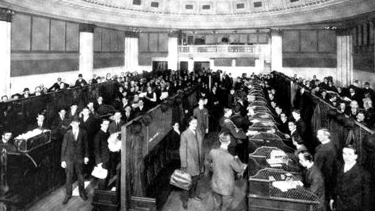
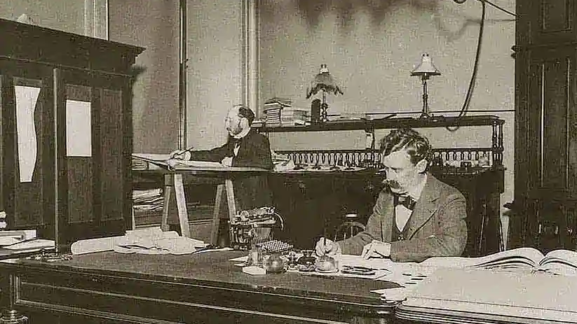
Correspondent Banking
Operate Bitcoin banking infrastructure for other banks
Institutional custody, exchange, and settlement rails
Extend distribution using existing compliance and operations capabilities

Slide 61
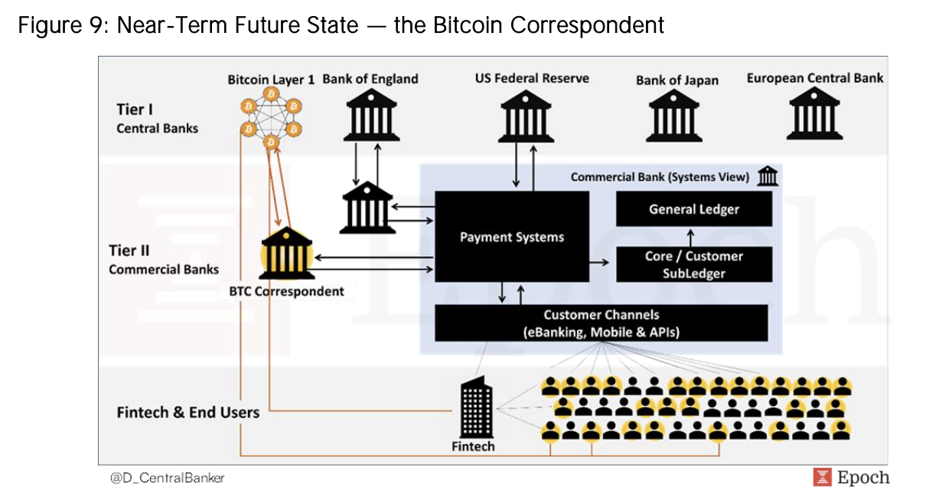
Correspondent Banking
Source: Epoch VC / @D_CentralBanker

Slide 62
Three monetary epochs
Asset-based
physical money
Debt-based
ledger money
Asset-based
ledger money
3000 BC
1600 CE
2009 CE
Notes:
% growth of bitcoin vs gold in the last 15 yrs

Slide 63
Wrap-Up
1. Bitcoin is disruptive technology
2. Banks are uniquely positioned
3. The decision is how to engage

Slide 64
Next Steps
1. Answer: “Is it real?”
2. Analyze: Use cases and business models
3. Act: Build, buy, or partner

Slide 65


Thank you
Andrew Begin
CSO, Galoy
X / LinkedIn
@agbegin

